Slide 1
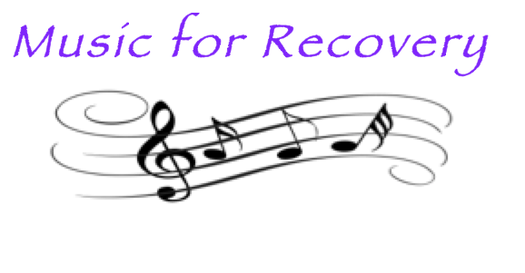
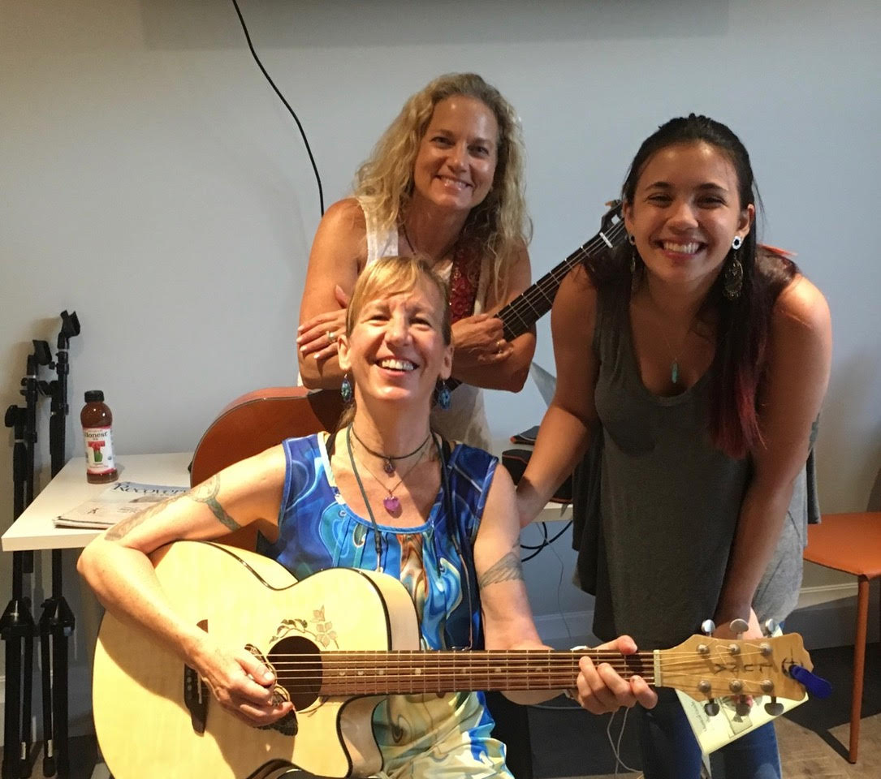
Our Vision
Evidence-based,
clinically integrated
music programming will become a standard part of addiction treatment.

Slide 2
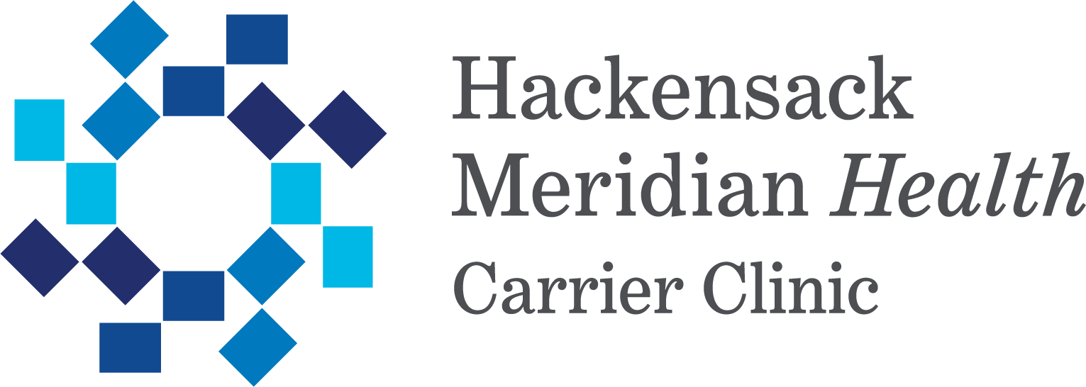
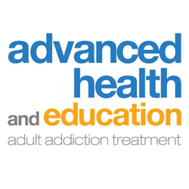
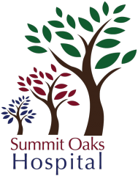
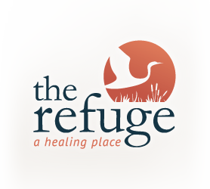
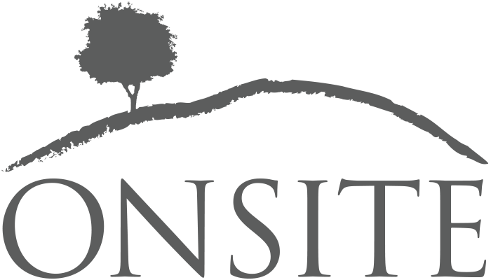
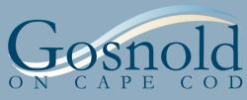
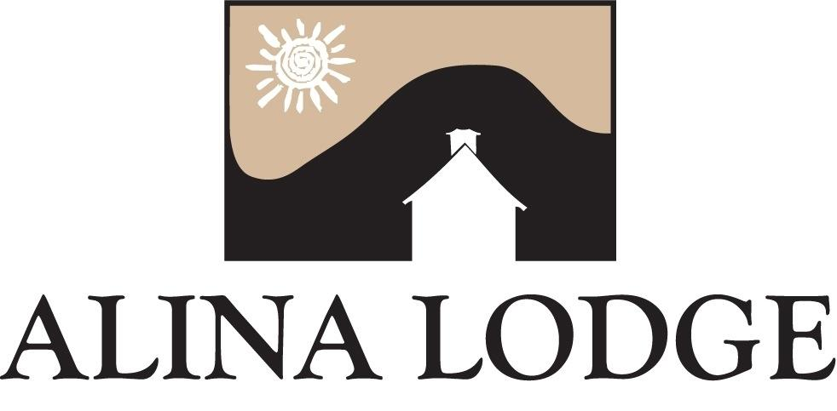
Our 12 Year History
Notes:
founded over 10 years ago
worked at Caron, The Meadows, Ashley, Daytop, Carrier Clinic, Alina Lodge and more

Slide 3
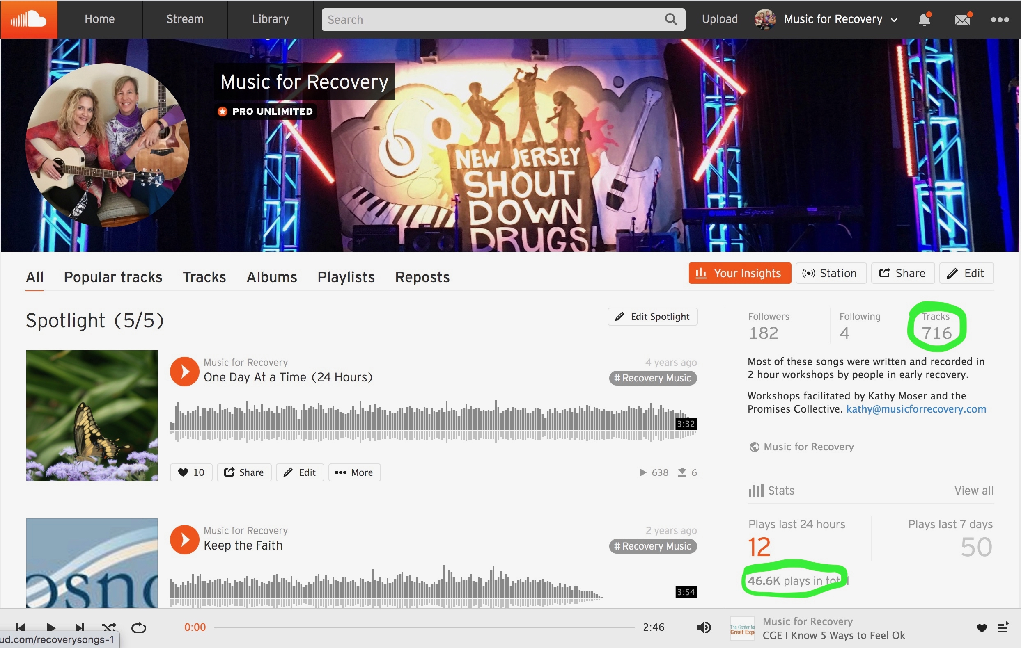
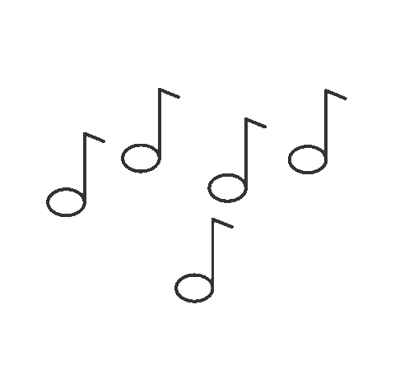
Over 700 Songs streamed over 46,000 times
Notes:
Over those ten years we’ve taught over 500 lessons and helped clients write over 600 songs that have been streamed over 45,000 times post treatment

Slide 4
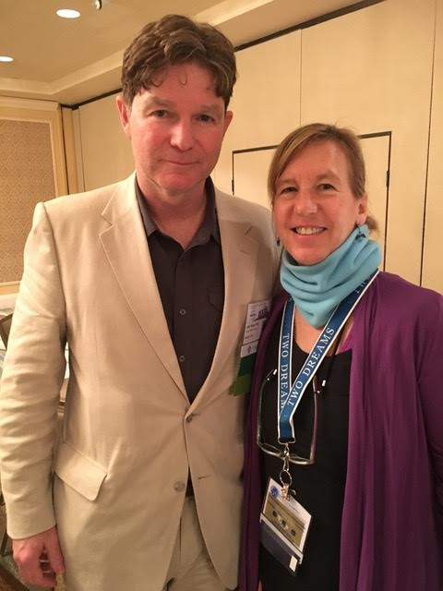
Recovery Research Institute at Harvard & MGH 2016 Study of Music for Recovery
“Music for Recovery participation is shown to enhance the therapeutic factors of installation of hope, catharsis, universality, and interpersonal connections in patients undergoing residential treatment for
substance use disorders.”
-Lead Researcher
John F Kelly, Ph.D.
Associate Professor of Psychiatry
Harvard Medical School
Director, MGH Recovery Research Institute
Program Director, MGH Addiction Recovery Management Service
Associate Director,
MGH Center for Addiction Medicine

Slide 5
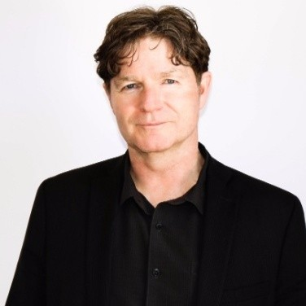
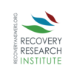
Recovery Research Institute at Harvard & MGH 2016 Study of Music for Recovery
“a promising programmatic element that could enhance engagement and retention in treatment by mobilizing common therapeutic mechanisms that ultimately enhance the likelihood of long-term recovery.”
-Lead Researcher
John F Kelly, Ph.D.
Associate Professor of Psychiatry
Harvard Medical School
Director, MGH Recovery Research Institute
Program Director, MGH Addiction Recovery Management Service
Associate Director,
MGH Center for Addiction Medicine

Slide 6
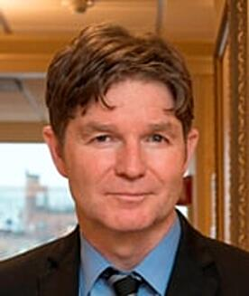
Recovery Research Institute at Harvard & MGH 2016 Study of Music for Recovery
2021 Keynoter at NCAD East
“Using the creative process of generating words and music for a song can be used therapeutically to provide individuals with a deeper emotional processing of experience that bypasses our normal cognitive defenses and filters. When done in a group format, this also fosters a sense of belonging and cohesion through common shared experiences that
builds a greater sense of community.”
-Lead Researcher
John F Kelly, Ph.D.
Associate Professor of Psychiatry
Harvard Medical School
Director, MGH Recovery Research Institute
Program Director, MGH Addiction Recovery Management Service
Associate Director,
MGH Center for Addiction Medicine

Slide 7
Clients Love Music Programming
Summit Oaks Hospital Data Oct 2020 – April 2021
73.9% report feeling less stressed after music activity 91.3% would recommend to peers 91.3% report it as being helpful to their treatment
“We did exactly what we all talked about fearing.. working as a group! Thank you” Megan age 20, Seabrook House, NJ
"This was awesome even though I was very skeptical. Thank You!”
Jamie age 28 Miller House, MA
“It was so much easier to identify with specific subjects through the music – wonderful program.” Siyanna 58, Emerson House, MA

Slide 8
Benefits to Your Facility enhances therapeutic alliance client retention marketing fundraising staff engagement aftercare
Notes:
playing an instrument increases brain connectivity

Slide 9
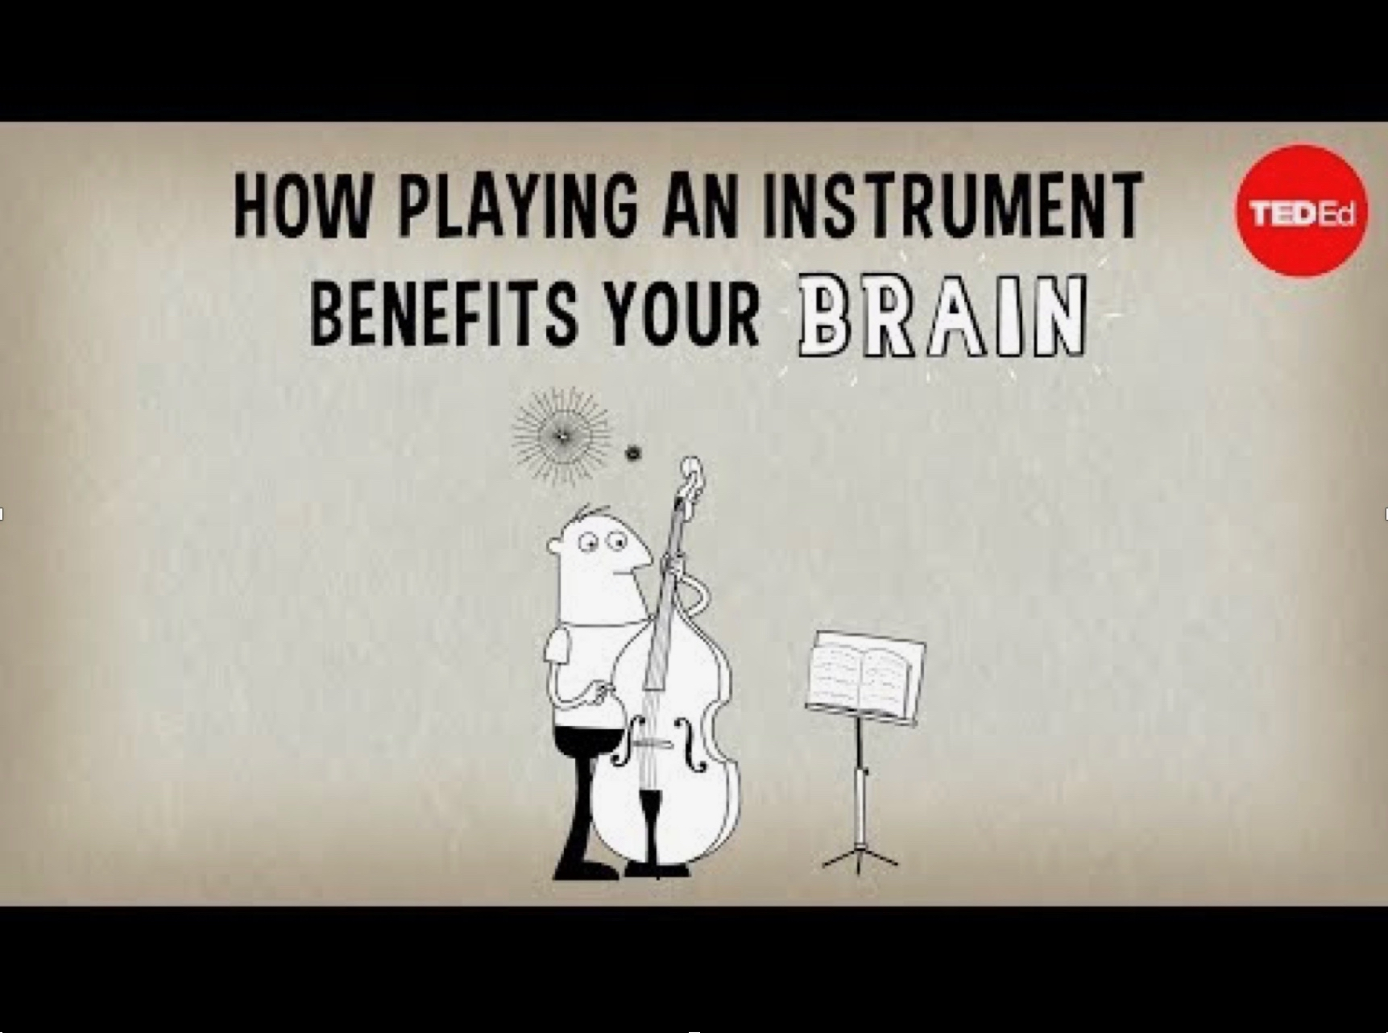
Why It Works
Real Time Functional MRI Studies Show:
Playing a musical instrument is the
#1 way to increase brain connectivity
Which improves:
Memory
Creative Problem Solving
Executive Function
Decision Making
Evidence Based & Scientific
Notes:
playing an instrument increases brain connectivity

Slide 10
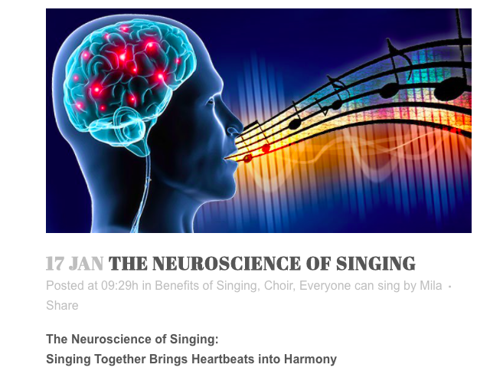
Singing is proven to create
Empathy & Cohesion
in Groups
It also elevates mood and strengthens the immune system
It is also easy to create and implement
Notes:
singing creates empathy and cohesion in groups, elevates the immune system and mood

Slide 11
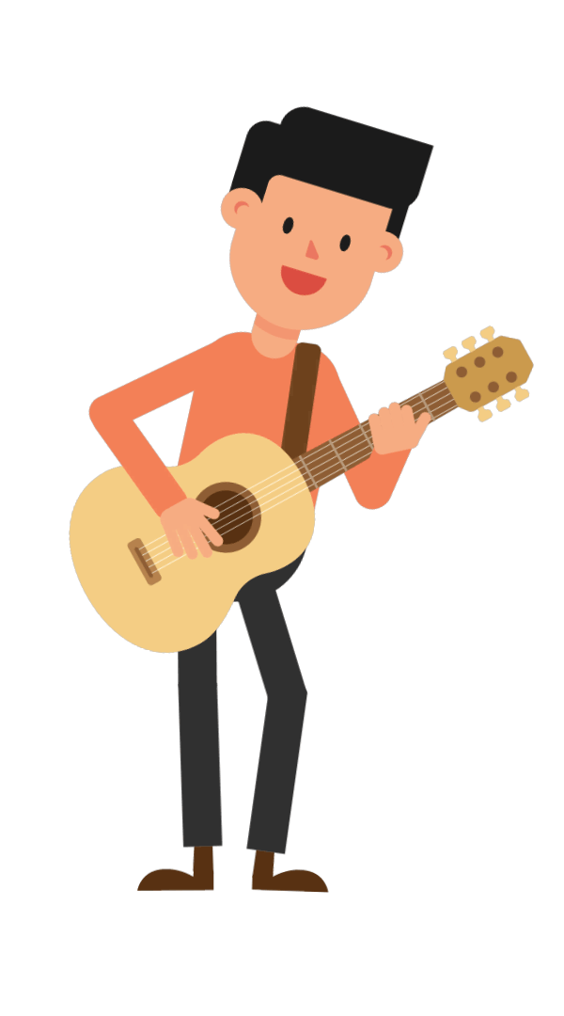
The Gifts of the Creative Process
The process of creating and learning music offers hands-on opportunities to learn and practice skills that directly apply to recovery!
Plus it’s fun!!

Slide 12
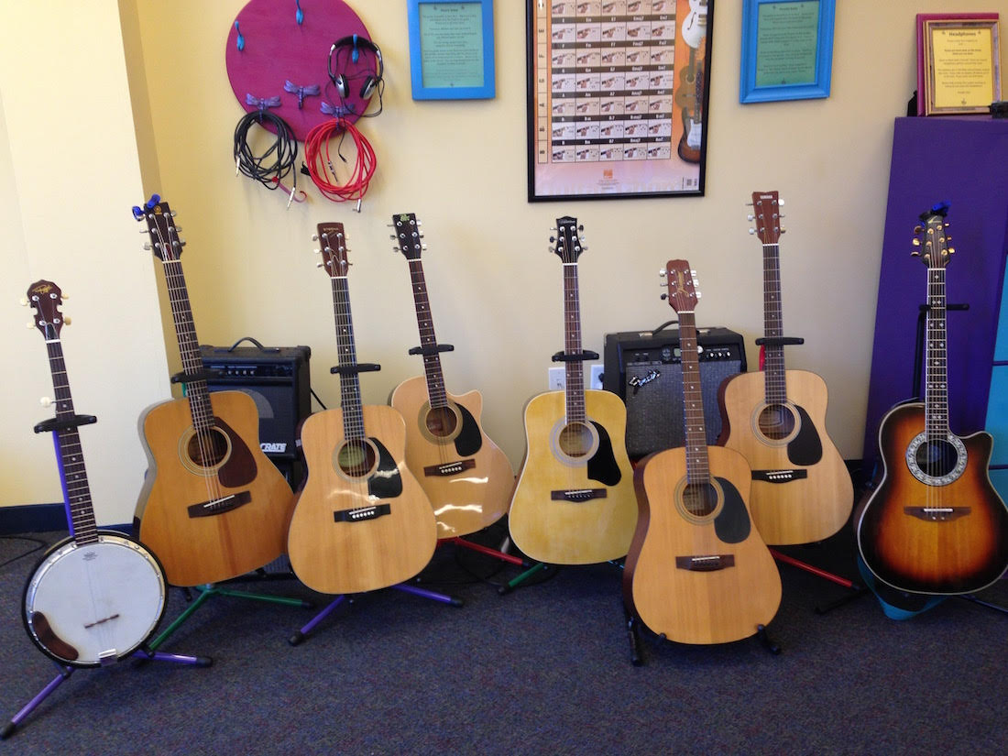
Music For Recovery In Action!
What We Can Implement in Your Facility

Slide 13
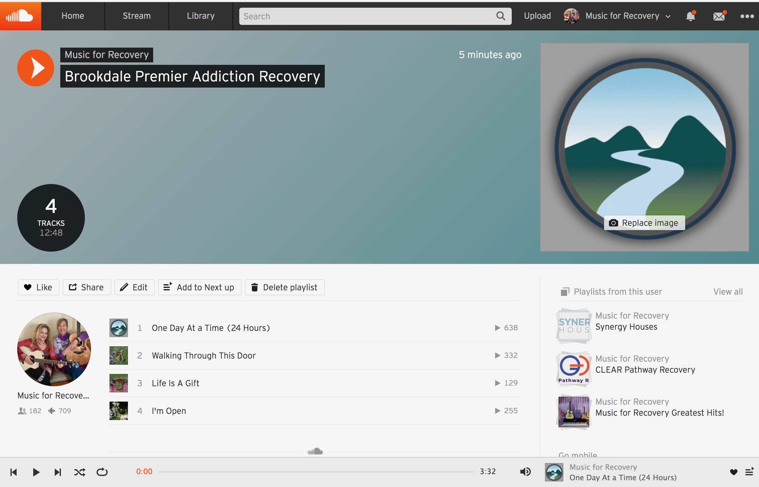
Recovery Songwriting Workshops
Clients strengthen their recovery skills through writing and recording an original song on a recovery topic. Includes a facility specific SoundCloud page where clients can access their songs for free. We offer this for groups and individuals.
“

Slide 14
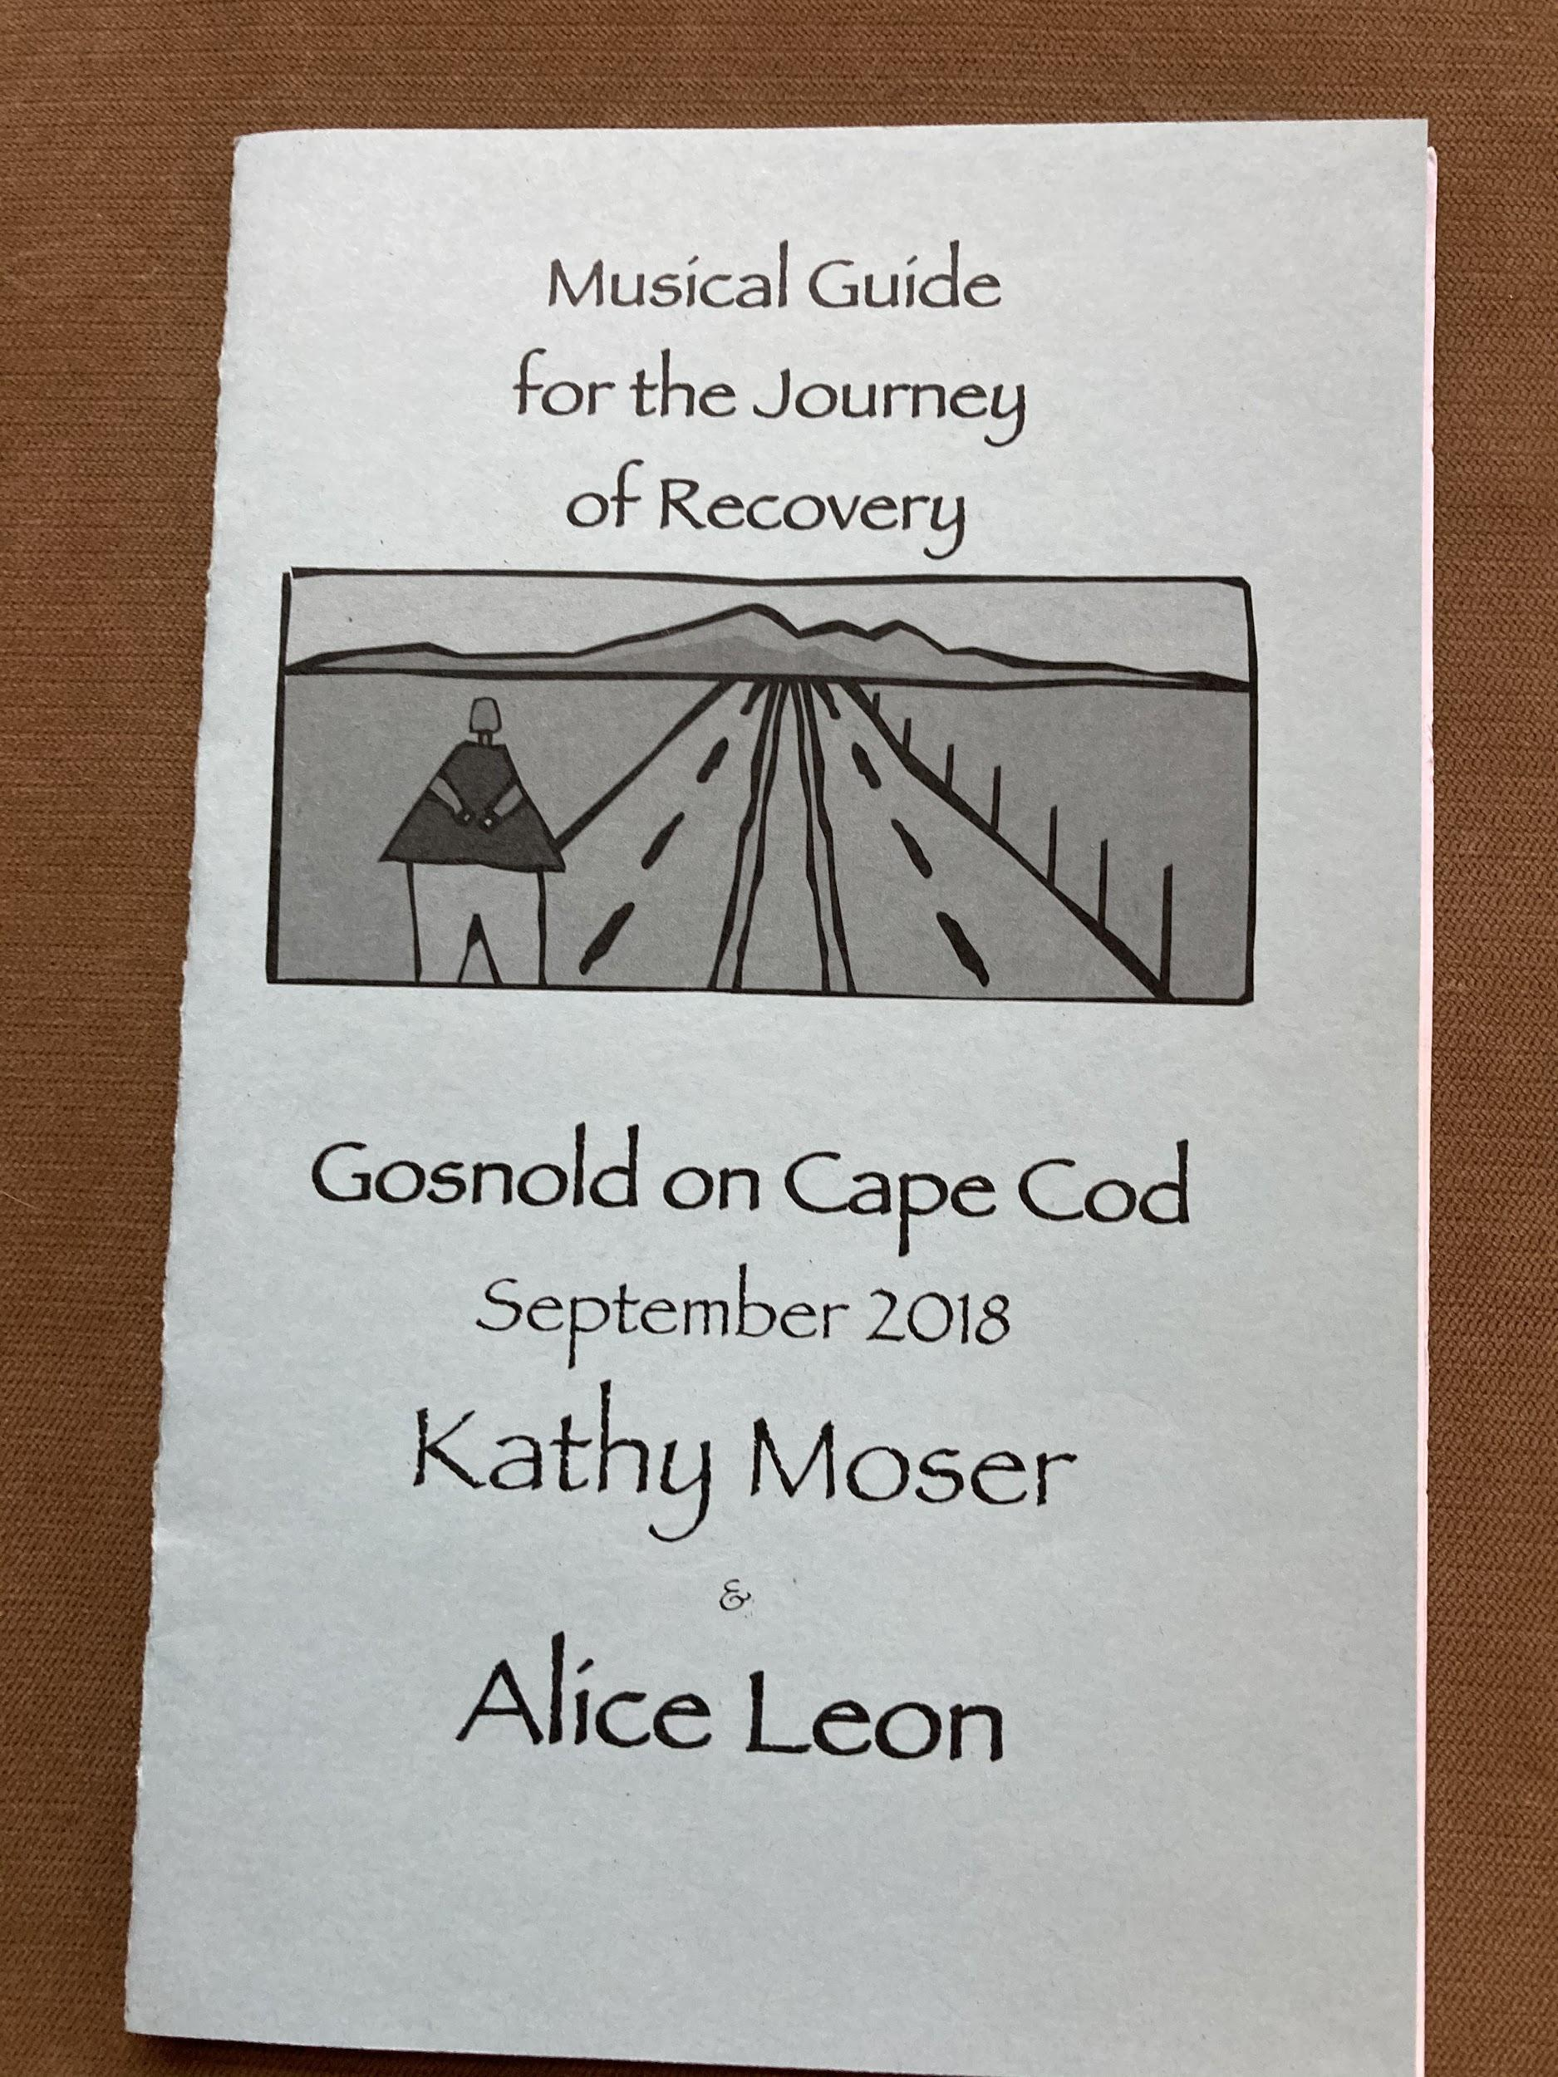
2. Recovery Concerts
Highly interactive and engaging concert that covers the emotions of early recovery and how to get through them clean and sober.

Slide 15
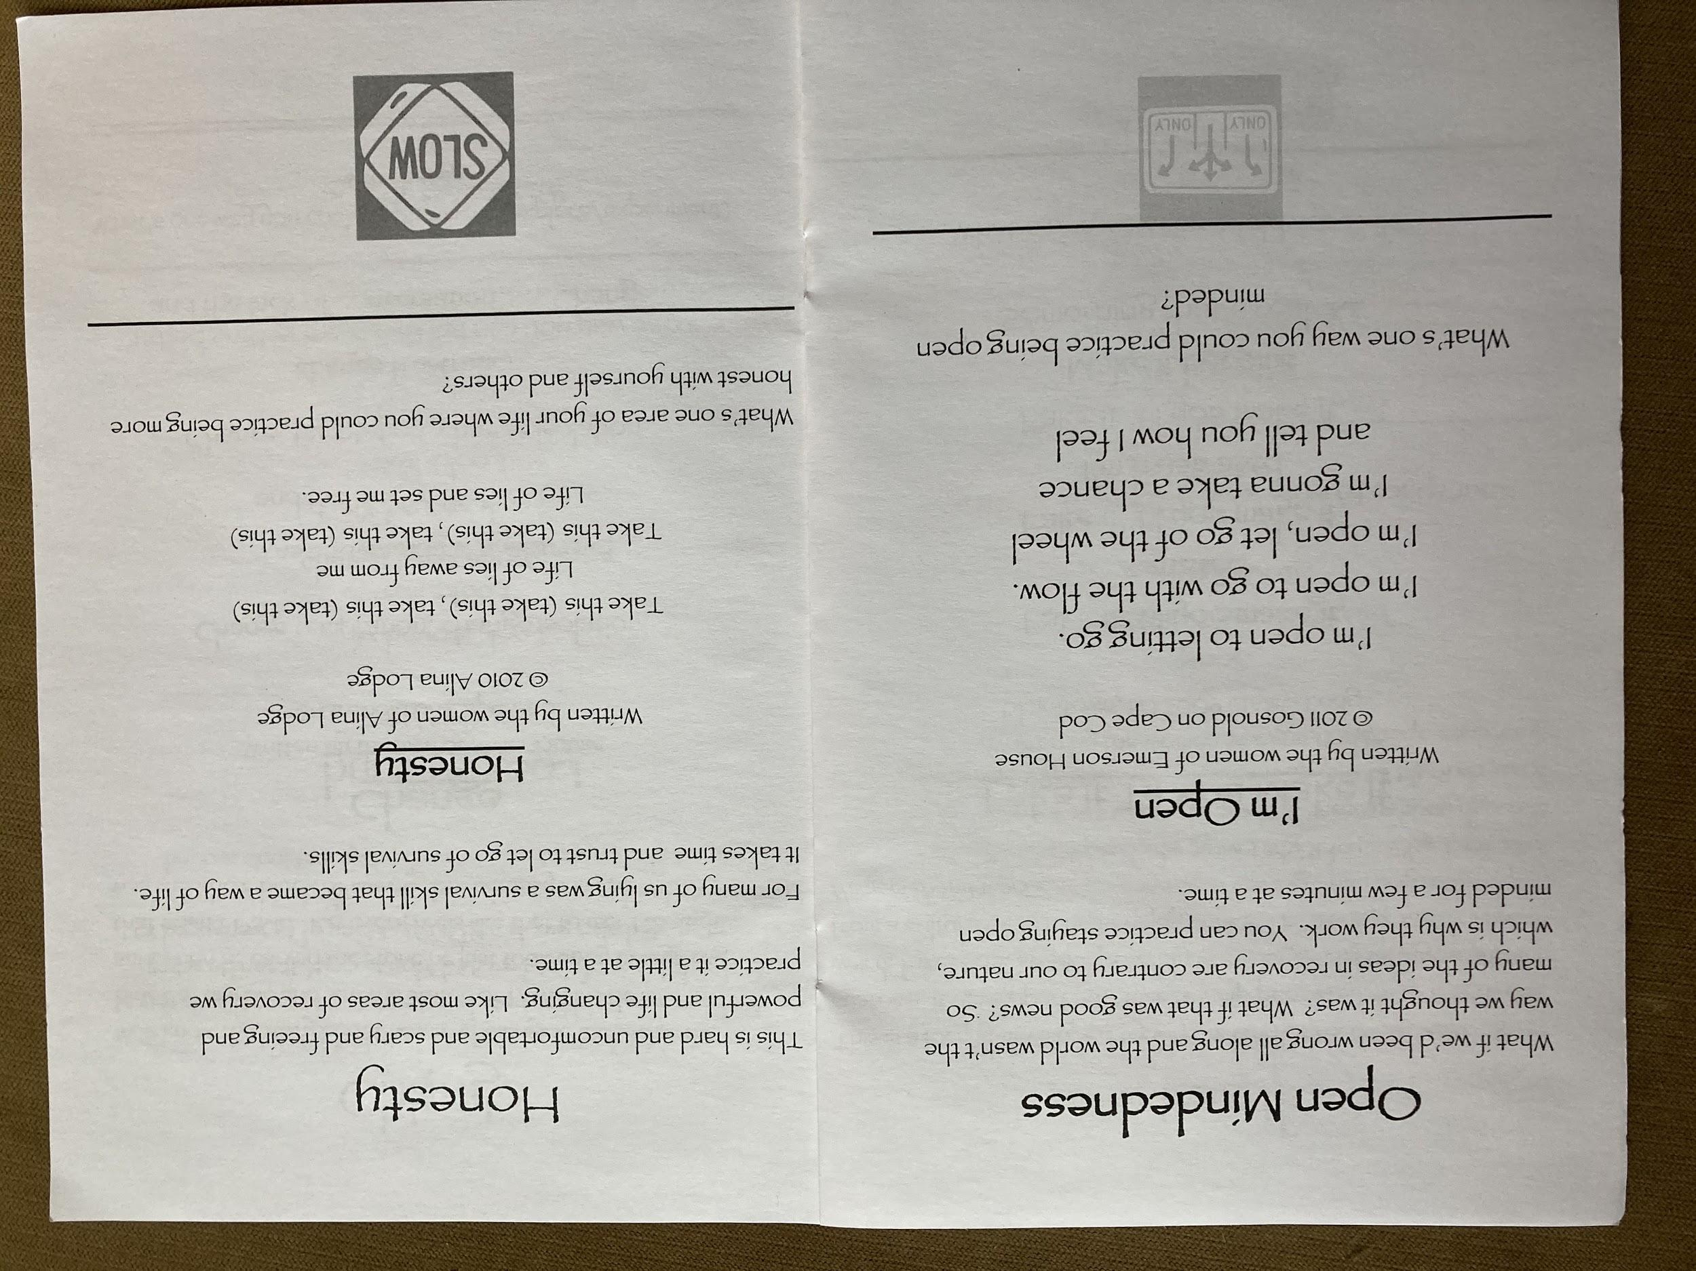
Each client receives this 16 page booklet with the lyrics and follow up questions on the topics. These are great for running a post-concert group.

Slide 16
3. Musical Instrument Learning Studios
Playing a musical instrument is the #1 way to increase brain connectivity. It is also a great sober hobby and way to develop skills needed for recovery such as slowing down, letting a process unfold, repetition and more. We can order, set up, deliver and install systems that are super easy to use and learn. We also provide instrumental lessons both in person and remotely.
The Music For Recovery Studio at Daytop NJ

Slide 17
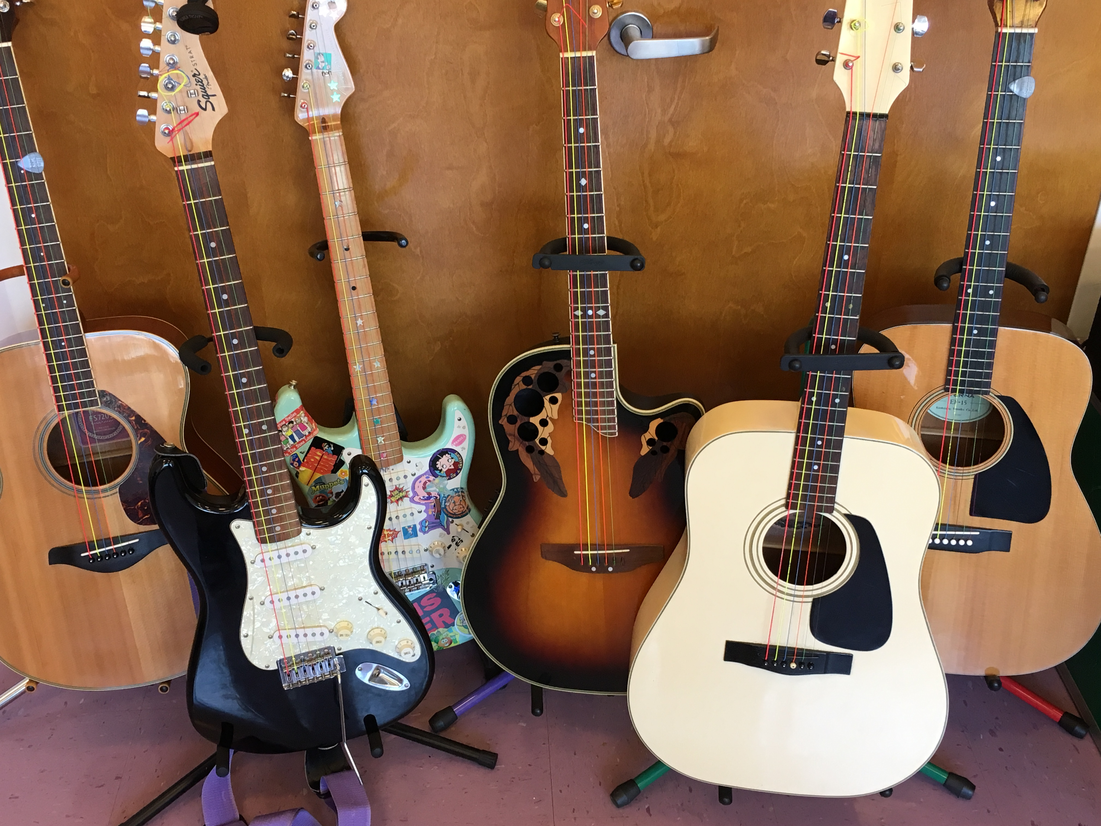
4. Creating Clinically Integrated Music Programming
We will collaborate with your clinicians to develop music programming that aligns with their treatment styles and modalities, as well as the language and culture of your facility. For example, doing motivational interviewing to a beat.
We are happy to explore creating custom programming for you as well.

Slide 18
5. Recovery Music Lessons

Slide 19
Contact Music For Recovery today! Kathy@musicforrecovery.com 908-591-4541 musicforrecovery.com

